Slide 1
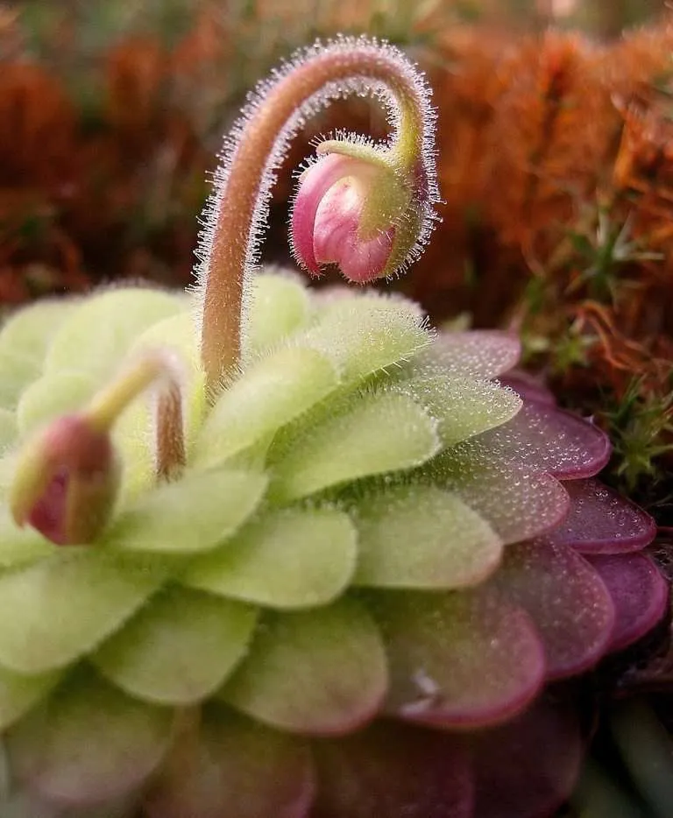
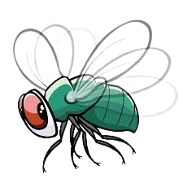
Is this a Butterwort?
Press the buttons below and see if you are correct!
YES
NO

Slide 2
Incorrect
Press the button to try again.
TRY AGAIN!

Slide 3
CORRECT!
This is a
Butterwort!
GREAT JOB!
Lets see if you can identify more plants!
Click anywhere to continue
NEXT

Slide 4
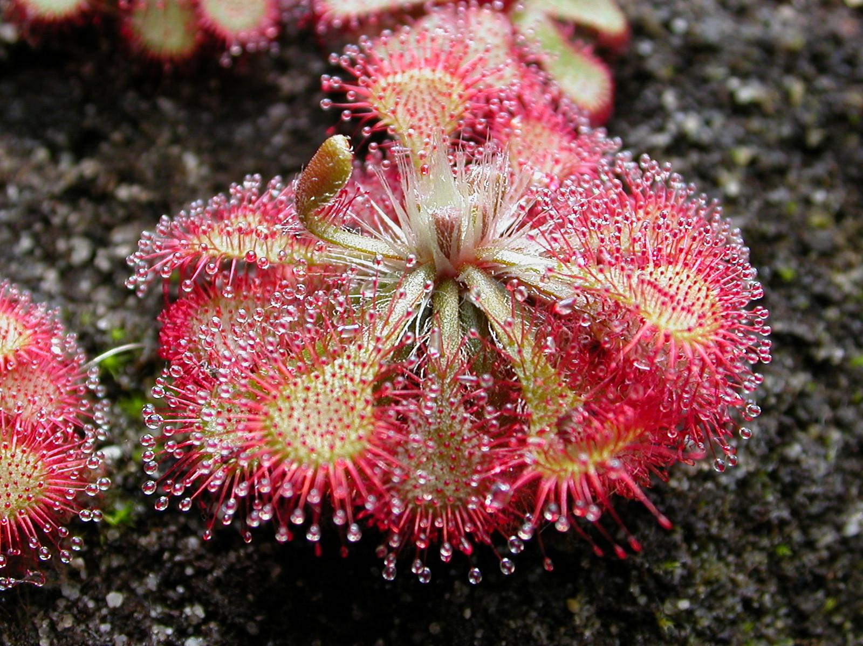
YES
Is this a Butterwort?
NO

Slide 5
Incorrect
Press the button to try again.
TRY AGAIN!

